Slide 1

IOT based Solar Monitoring Dashboard
Software Engineering Project

Slide 2
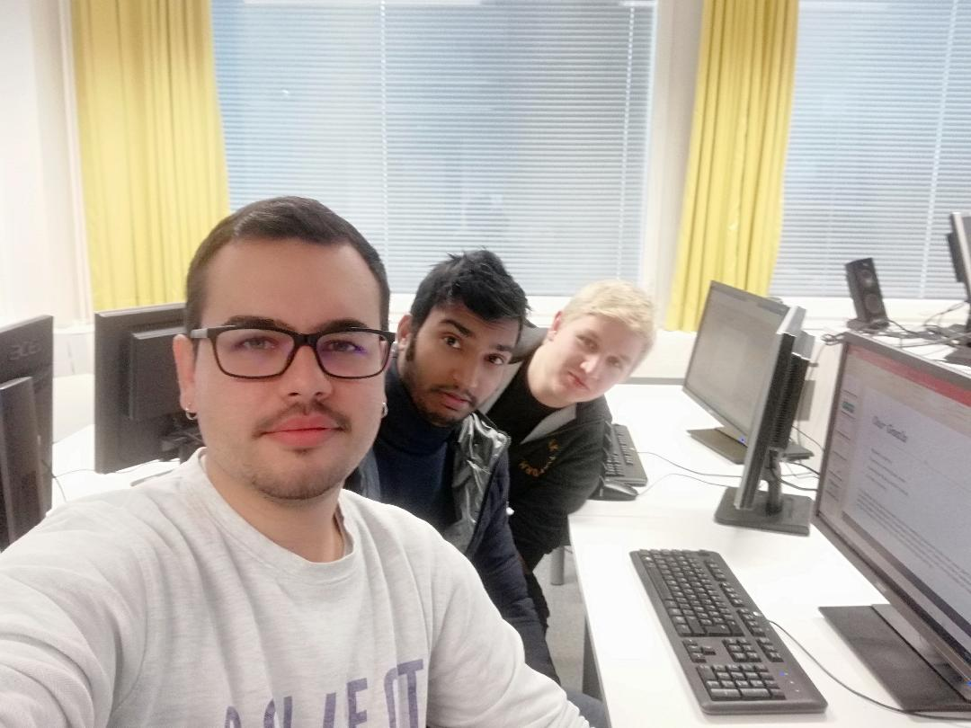
Our Team
1. Md Farukul Islam (Project Manager)
2. Albin Westerlund (Team member and Developer)
3. Carlos Martinez de la Riva Valdaliso (Team member and Developer)
Our Client
1. Timo Kankaanpaa

Slide 3
Overview
Iot-ticket
Our Goals
Project Roadmap
Working Methods and Tools
Conclusion
References

Slide 4
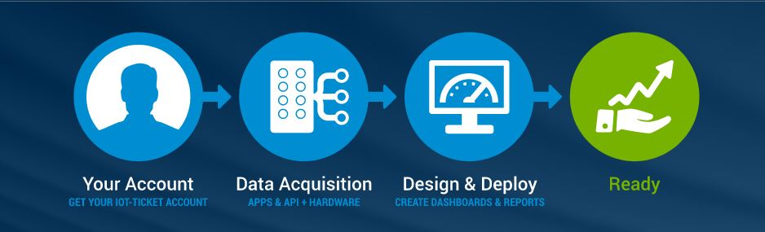
Iot-ticket
IoT-Ticket is a complete remote management system that includes the electronics, software and server.

Slide 5
Our Goals
Our primary goal is to remotely monitor the electricity production at the solar power plant using iot–ticket interface and making dashboard.
Regulatory reporting
Supervisory monitoring and control
Operational efficiency and KPI tracking
Condition monitoring

Slide 6
Project Roadmap
The project is done by using the scrum method and sprints.
On every lecture ( weekly 2 lecture) we stand for our scrum meeting on VAMK campus.
The project is divided into three sprints.
Each sprint contains 10 issues/tasks based on our project.
We use Redmine for maintaining schedule, task, project file and kanban board.

Slide 7
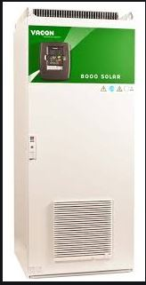
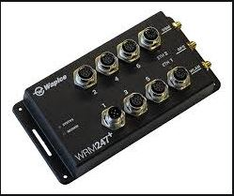
working methods and tools
Wapice’s IoT Ticket Online platform for Creating Dashboard,
Wapice’s WRM 247+ module
Vacon 8000 inverter at Technobotania
https://git.vamk.fi/e1701764/iot_solarplant

Slide 8
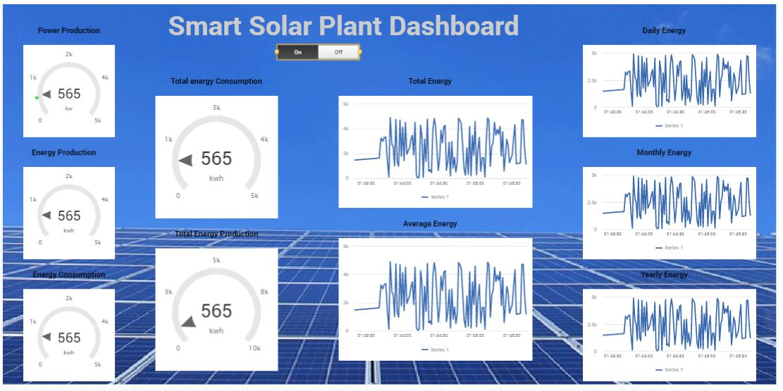
Our First Prototype Dashboard V-0.01

Slide 9
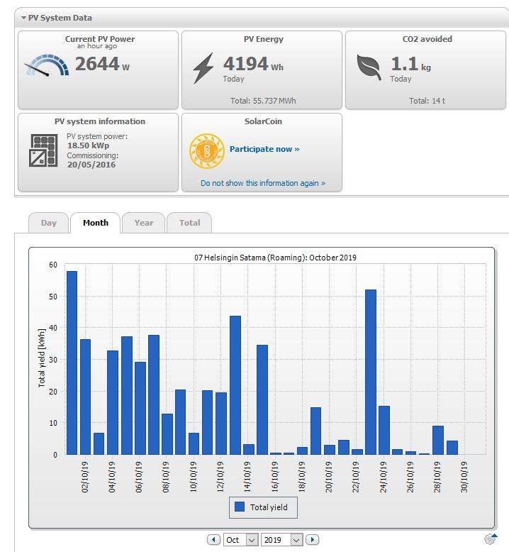
Our Mockup

Slide 10
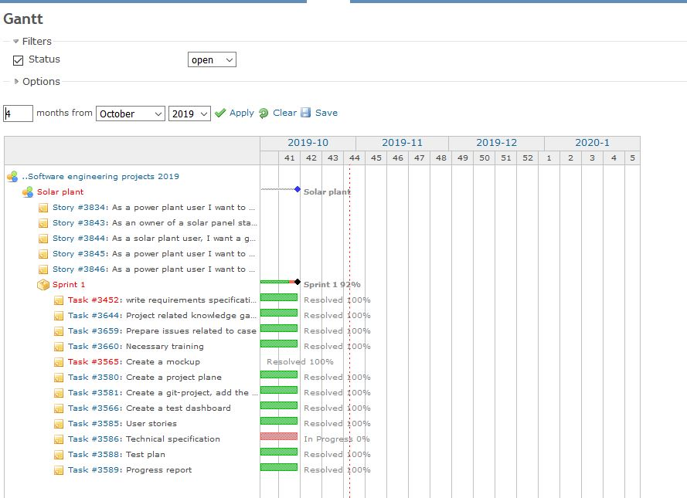
Sprint 1

Slide 11
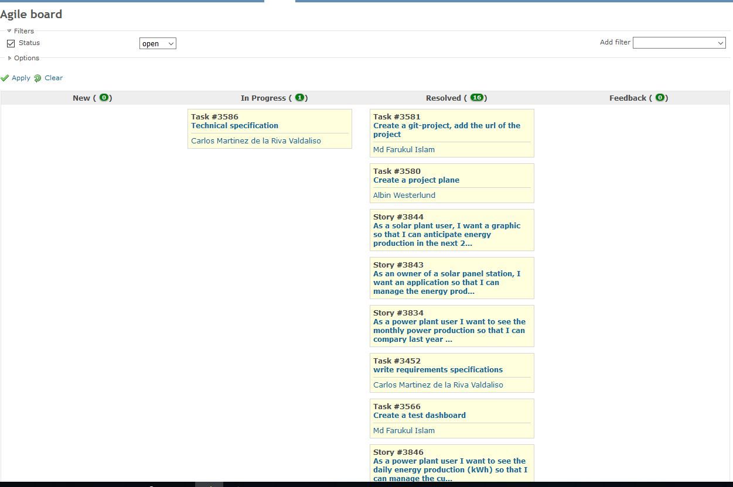
Kanban board

Slide 12
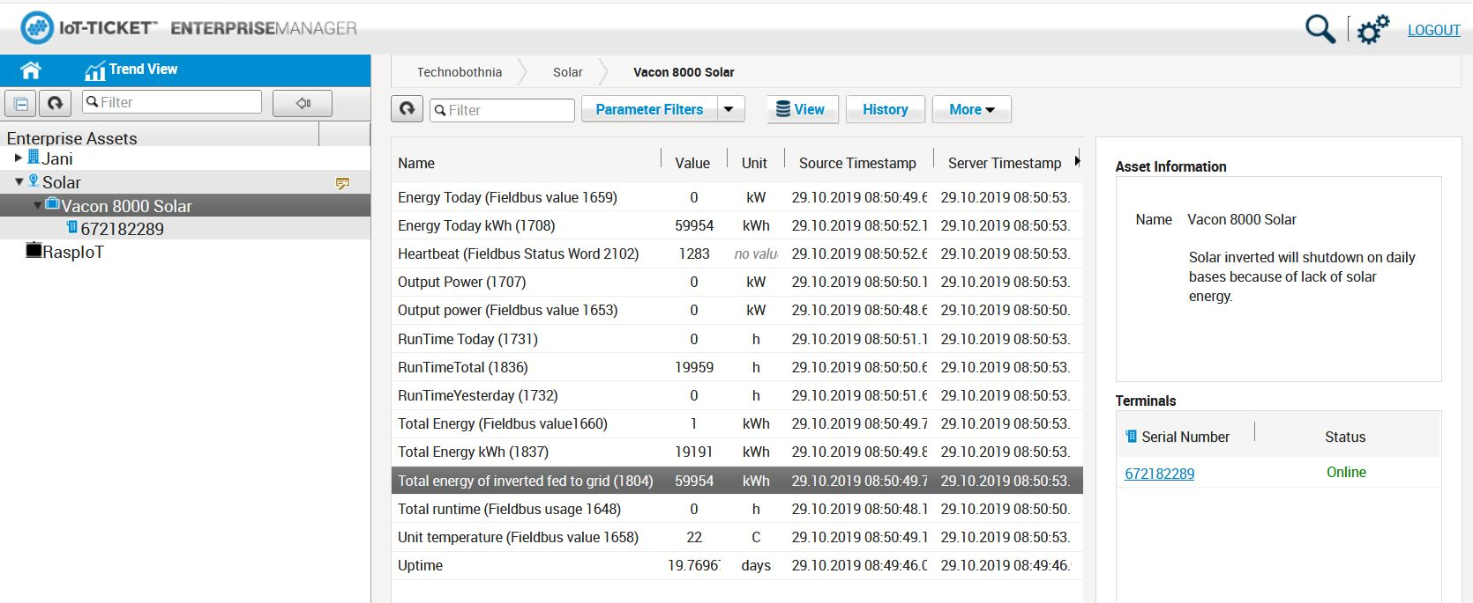
WRM247+ online

Slide 13
Conclusion
Remote monitoring and control of assets
Modern, easy to use, web-based UI
Powerful report creation and analytics
Big-data enabled and inbuilt security
So, by using of IoT is proving to be beneficial for monitoring power generation from our solar plant.

Slide 14
Reference
VACON-8000-Solar-NXV0010-NXV0100-Manual-DPD00426A-UK
WRM247+_DataSheet_2015
https://iot-ticket.com/platform

